Slide 1
Analyzing Amazon Sales Data

Slide 2
INTRODUCTION
The project revolves around conducting an in-depth analysis of sales data from Amazon, one of the world's largest e-commerce platforms. Through advanced analytics techniques, we aim to extract valuable insights from the dataset to better understand sales performance across different regions, product categories, and sales channels.
By descriptive, diagnostic, predictive, and prescriptive analytics, we will uncover patterns, trends, and relationships within the data. This analysis will enable us to address key business questions.
Through rigorous data analysis and visualization techniques, we will present our findings in a clear and concise manner, facilitating informed decision-making for stakeholders. Ultimately, this project aims to demonstrate the power of analytics in extracting actionable insights from complex datasets to drive business growth and success

Slide 3
Workflow
Data Collection
Data Cleaning
Data Analysis
Insights
Summary

Slide 4
Data Collection
The Data has been collected in the form of a CSV file named “Amazon Sales Data.csv”.
The CSV file has the data of sales of products during the timespan of 2010 and 2017.

Slide 5
Data Cleaning
There were no Null values or blank fields
Some values in ‘Order Date’ and ‘Ship Date’ columns are in String datatype. So we converted them to datetime datatype using Python
Most of the values in ‘Total Revenue’, ‘Total Cost’ and ‘Total Profit’ columns are written with two decimal places, so we make sure that each value in these columns have two decimal places by using Excel

Slide 6
key features and elements of the dashboard
Key Metrics:
Total Cost, Unit Cost, Total Profit, Average Profit Margin(APM), Average Unit Cost and Total Revenue are prominently displayed, providing an overview of financial performance.
Countries Wise Profit:
A world map visualization highlights profit levels across different countries, offering geographic insights into sales performance.
Total Profit by Region:
A pie chart illustrates the distribution of total profit among different regions, enabling users to understand regional contributions to overall profitability.

Slide 7
Total Profit by Region (Offline vs. Online):
Another bar chart compares the total profit generated from offline and online sales channels, helping users evaluate channel performance.
Total Profit by Region (Bar Chart):
A horizontal bar chart further visualizes total profit by region, facilitating easy comparison and analysis.
Ship Date Filter:
A list of ship dates enables users to filter data based on specific time periods, allowing for dynamic analysis and exploration.
Profit Margin by Region:
A bar chart visualizes profit margins across regions, allowing users to compare profitability and identify areas for improvement.
Units Sold by Region:
A horizontal bar chart displays the number of units sold in each region, providing insights into sales volume distribution.

Slide 8
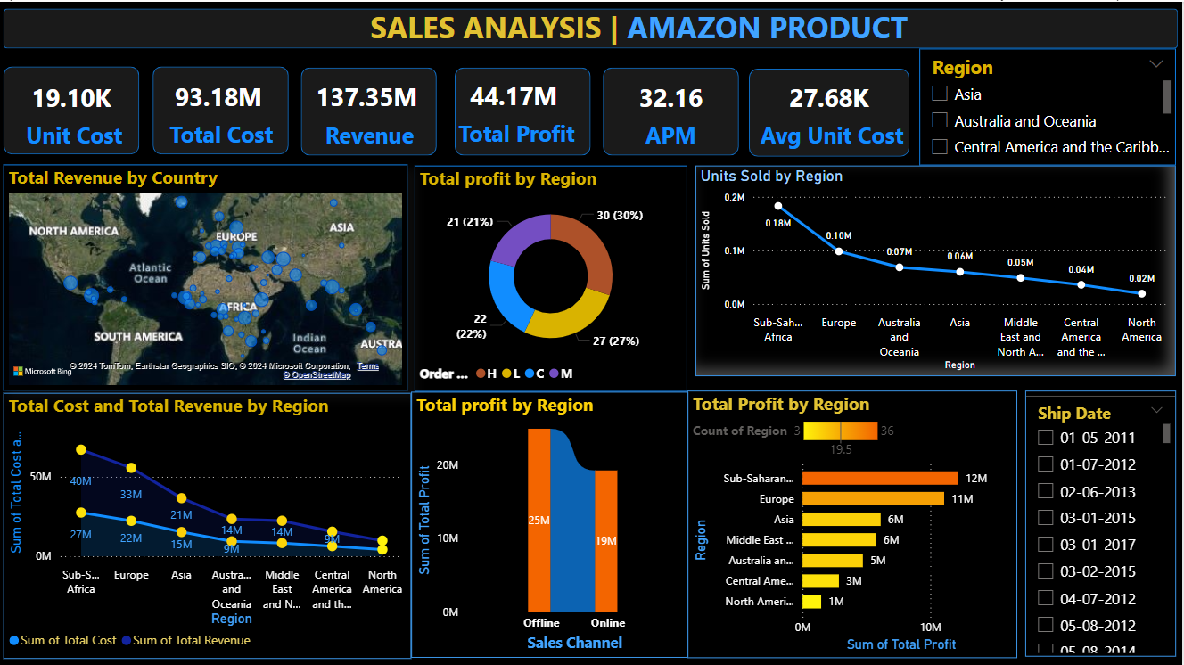
Dashboard

Slide 9
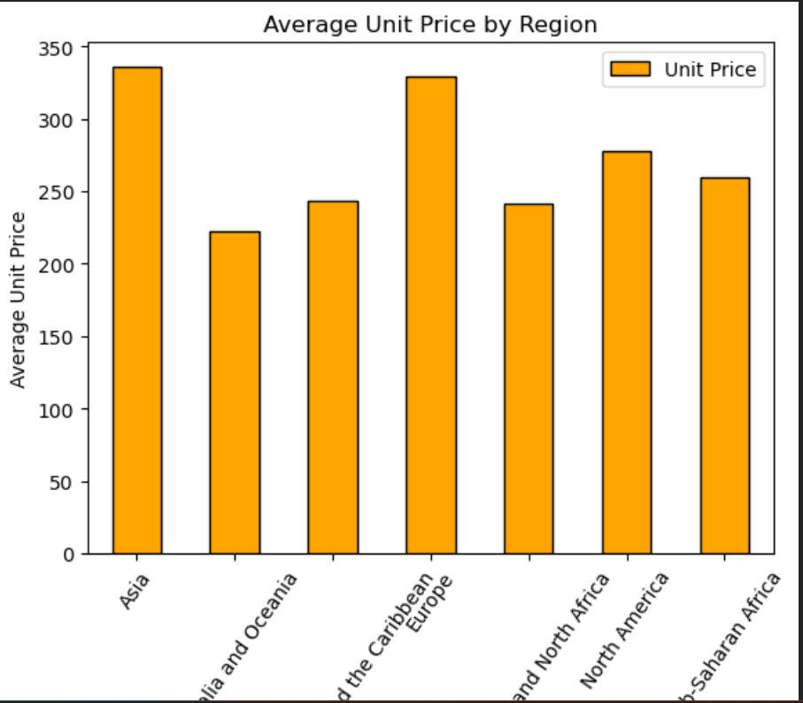
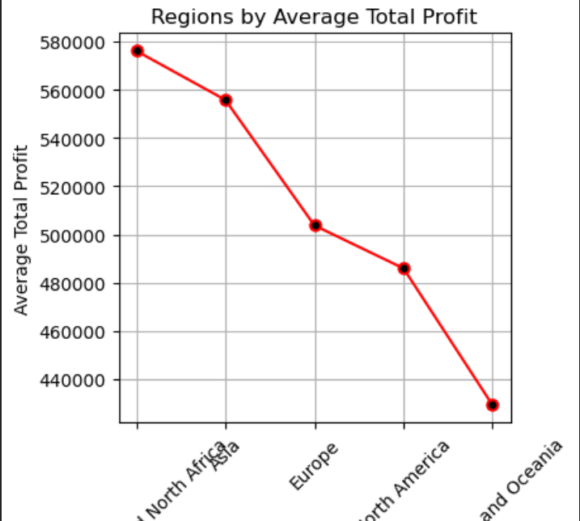
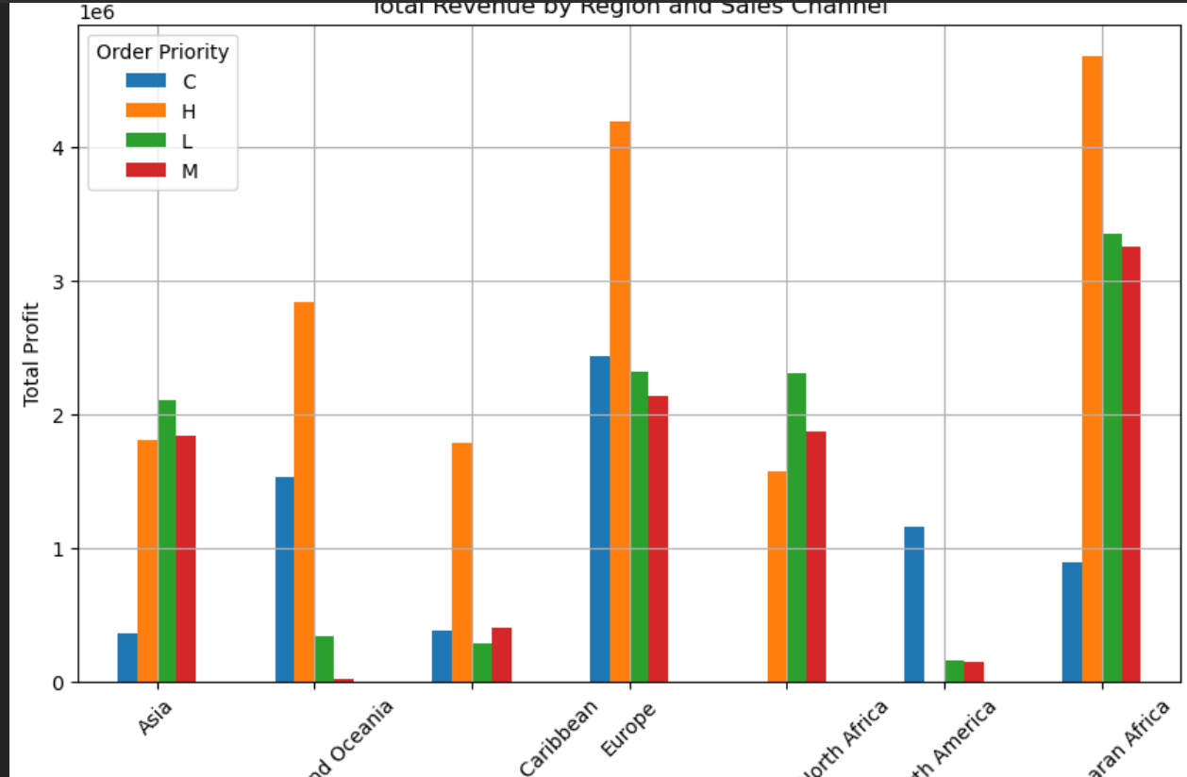
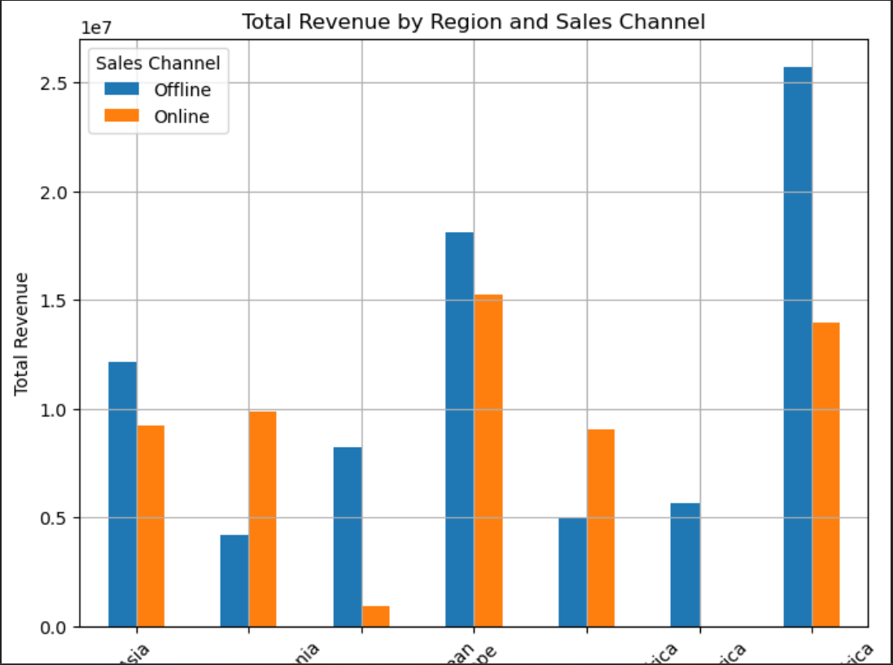
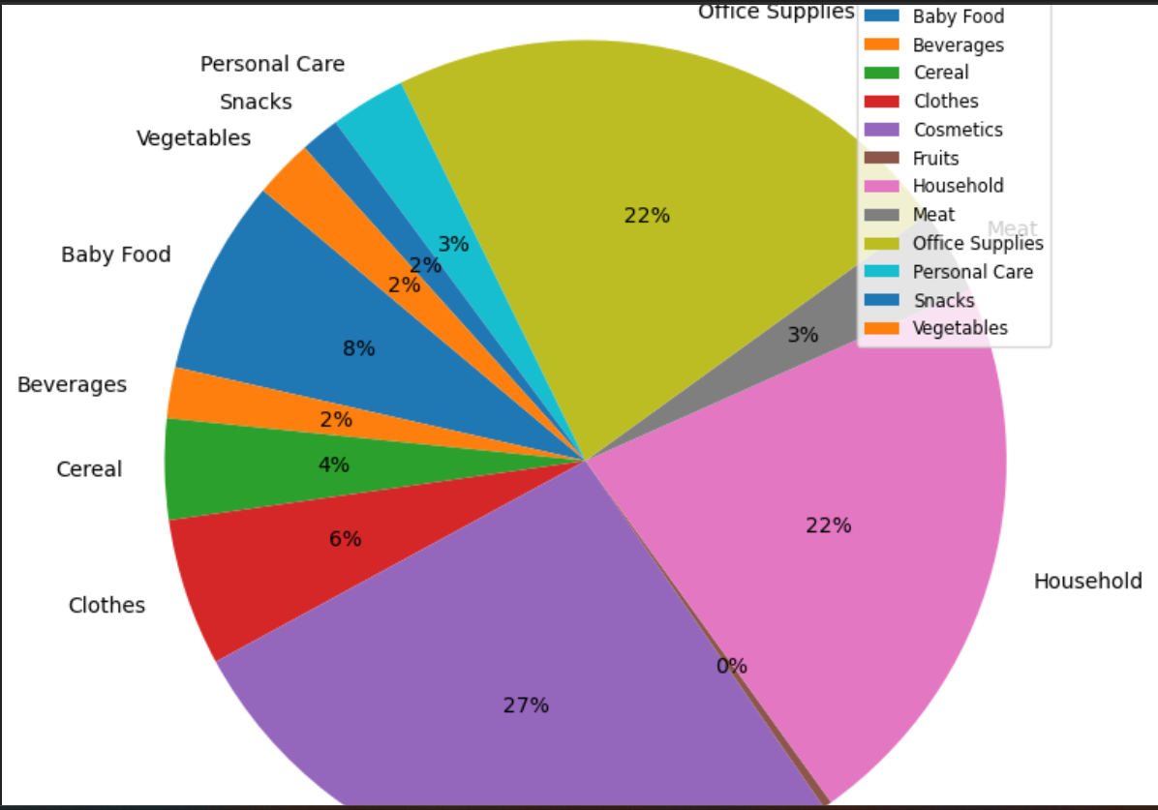
Observations

Slide 10
Insights
The total sales is $137.35 million out of which total profit is $44.17 million.
The average profit margin and unit price is $32.16 and $276.76 respectively.
The “H” order priority gave the highest sales, which means people need their products fast.
“Cosmetics” products gave the highest sales.
Majority of people still prefer “Offline Channel” for buying products.
The year 2012 has seen the highest sales
The Sub-Saharan Africa region has seen the highest sales

Slide 11
Summary
Cosmetic products are very popular among people of Europe and these products generated the highest profit ($14.56 million) of all items. So, it is advisable to create some marketing campaigns promoting Cosmetic products.
Total Population of North America prefer to shop offline as compared to people of Europe, who mostly prefer Online channel for shopping. But because high profits are coming from Online channel, it advisable to promote products online.
The Region Sub-Saharan Africa has generated the highest profit where people bought Fruits the most, with approx. 31 thousands unit sold. Highlight the health benefits of fruits during campaigns and align marketing with local preferences.
The second most purchased item, after Cosmetics in Europe is Baby Food. This insight tells us that majority of people of Europe are newlywed couples. Thus you can promote products related to new born babies to these people.

Slide 12
Fruits has generated the least profit of all item types which is only $120.50 thousands. It is advisable to understand the customer needs, adjust the price and analyse the local preference.
North America Region has generated the least profit by selling only Personal Care and Household Items through Offline Channel. Try to promote products other than both these item types through Online Channel by giving some discounts. Do some survey to find local people’s preferences.
Meat is the least sold item type with 11 thousands units sold in Australia and Oceania and Sub-Saharan Africa Region using only Online Channel. Consider selling different kinds of meat products and adjust the prices.
Household Items and Cosmetic Products are sold the most through Offline and Online Channels respectively. Enhance physical stores with attractive displays and promotions for Household Items. Run targeted ads and make the website more user friendly for Cosmetic products.

Slide 13
Thank you

